Slide 1
Day 3 – Azure Machine Learning Integration
BRK11 – Working with data sources and datasets (25 min)
ACT04 – MENTI: Best practices for securing data and protecting privacy
BRK12 – Azure Machine Learning integration with Azure Synapse Analytics (30 min)
LAB05 – Using Azure Machine Learning from Azure Synapse Analytics Studio
BRK13 – Azure Machine Learning integration with Azure Databricks (30 min)
ACT05 – DISCUSS: MLOps best practices
LAB06 – MLOps with Azure Machine Learning, Azure Pipelines, and GitHub
ACT06 – NENTI: Addressing the challenges of modern data science projects with Azure

Slide 2
BRK11 – Working with data sources and datasets
<Presenter name>
<Presenter title>

Slide 3
Agenda

Slide 4
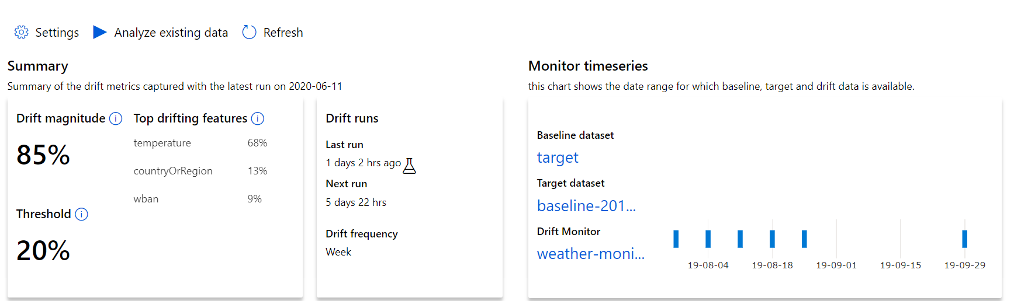
Detecting Data Drift with AML dataset monitors
Review results in AML Studio
Percent drift between baseline & target
Features which drifted the most
Drift beyond this will trigger alerts
Observe drift over time

Slide 5
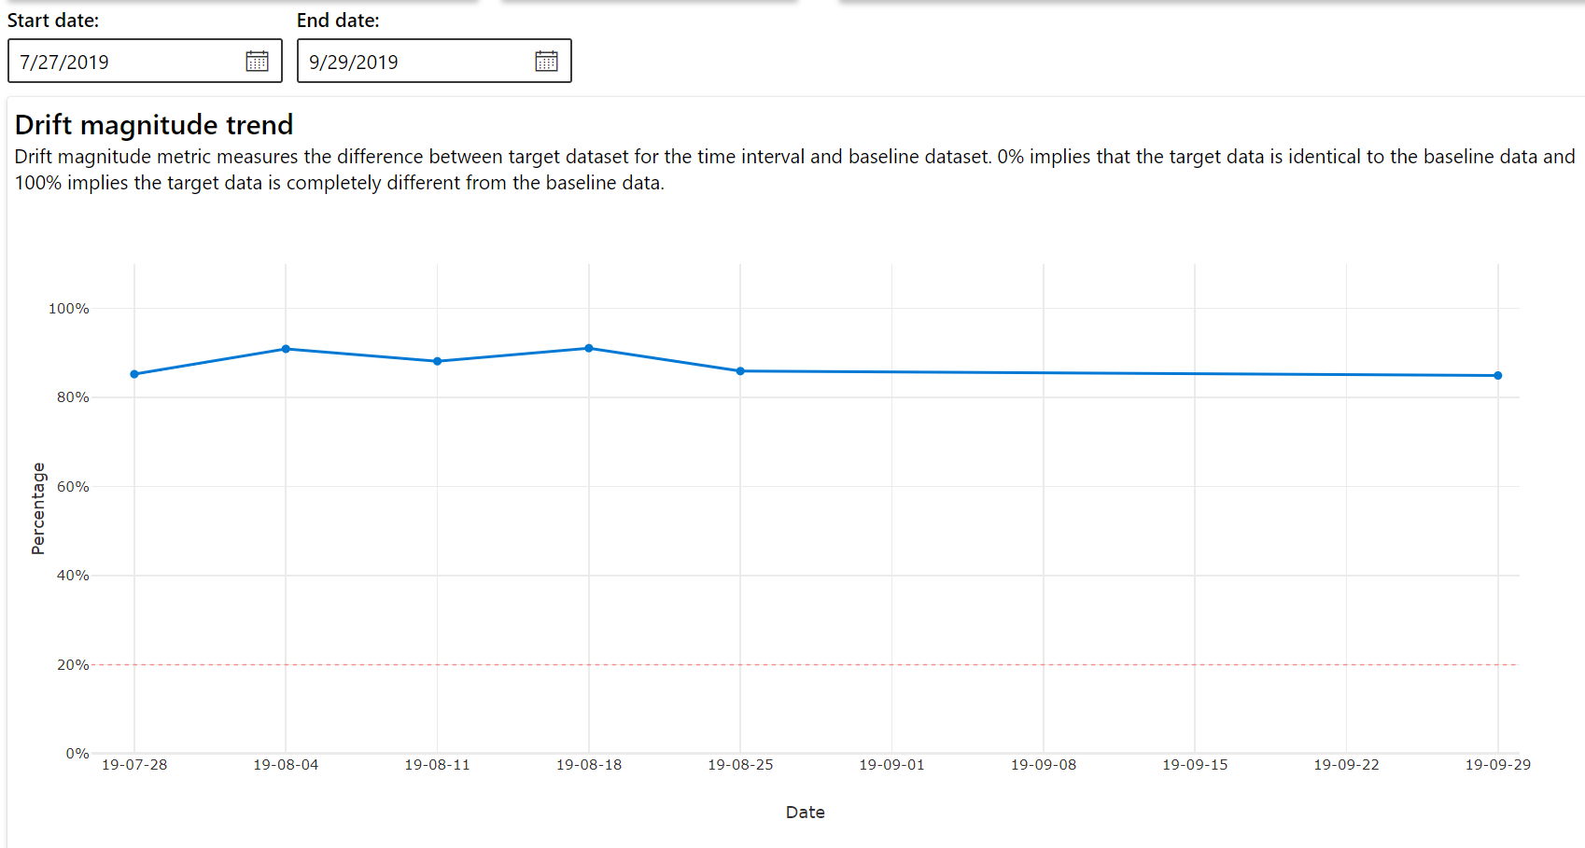
Detecting Data Drift with AML dataset monitors
Review results in AML Studio

Slide 6
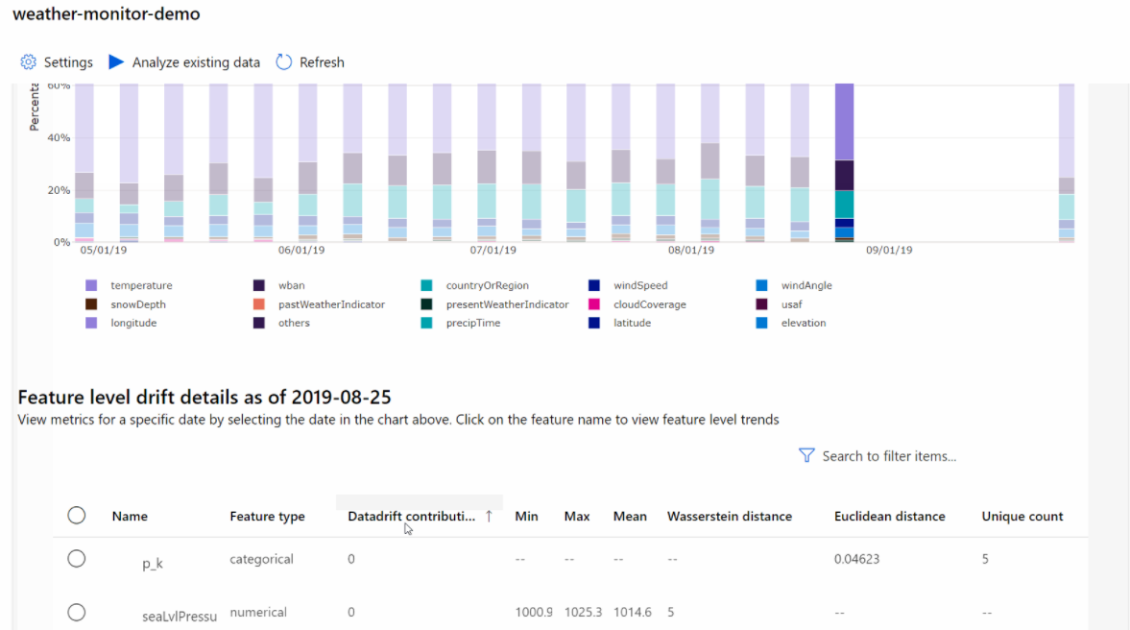
Detecting Data Drift with AML dataset monitors
Review results by feature
Numeric features | Categorical features
Wasserstein distance | Euclidian distance
Mean value | Cardinality (unique values)
Min value
Max value

Slide 7
Understanding Data Drift
Data drift happens over time.
Data drift affects models—they become less accurate as underlying circumstances change.
One solution: constant retraining. Downside: we’re constantly retraining!
Another solution: detect drift and retrain when needed.

Slide 8
Causes of Data Drift
Upstream process changes (e.g., placing sensors in new locations)
Data quality issues (e.g., broken sensor)
Natural drift in data (e.g., seasonality, change in tastes)
Change in relationship between features (i.e., covariate shift)

Slide 9
Detecting Data Drift with AML dataset monitors
Azure Machine Learning dataset monitors help track drift.
Create using AML Studio or the AML SDK
Supports both SQL and flat file data stores
Defines a baseline dataset that represents the original training data
Defines a target dataset that represents the scoring data
Requires timeseries dataset with timestamp column

Slide 10
Detecting Data Drift with AML dataset monitors
Define a variable named “state”
Step 1: Create a target dataset. Must have the timeseries trait:
Timestamp column in the data
Virtual column derived from the path pattern of files
dstore = Datastore.get(ws, 'your datastore name')
dstore_paths = [(dstore, 'weather/*/*/*/*/data.parquet')]
partition_format = 'weather/{state}/{date:yyyy/MM/dd}/data.parquet'
dset = Dataset.Tabular.from_parquet_files(path=dstore_paths, partition_format=partition_format)
dset = dset.with_timestamp_columns('date')
dset = dset.register(ws, 'target')
Define a variable named “date” based on folder names
Load data using the defined partition format
Specify that “date” is a timestamp column

Slide 11
Detecting Data Drift with AML dataset monitors
Set a baseline of expected activity
Step 2: Create a dataset monitor
dset = Dataset.get_by_name(ws, 'target')
baseline = target.time_before(datetime(2019, 2, 1))
features = ['latitude', 'longitude’, ... ]
monitor = DataDriftDetector.create_from_datasets(ws,
'drift-monitor’, baseline, target,
compute_target='cpu-cluster’,
frequency='Week’,
feature_list=None,
drift_threshold=.6,
latency=24)
Create a data drift detector object
Define frequency of scheduled tasks
How much drift is acceptable

Slide 12
Detecting Data Drift with AML dataset monitors
Backfill from January to May, 2019
Step 3: Run a backfill
monitor = DataDriftDetector.get_by_name(ws, 'drift-monitor')
monitor = monitor.update(feature_list=features)
backfill1 = monitor.backfill(datetime(2019, 1, 1), datetime(2019, 5, 1))
backfill1 = monitor.backfill(datetime(2019, 5, 1), datetime.today())
monitor = monitor.disable_schedule()
monitor = monitor.enable_schedule()
Backfill from May, 2019 to now
Stop performing drift detection
Start performing drift detection

Slide 13
Detecting Data Drift with AML dataset monitors
Review results in AML Studio
Percent drift between baseline & target
Features which drifted the most
Drift beyond this will trigger alerts
Observe drift over time

Slide 14
Detecting Data Drift with AML dataset monitors
Review results in AML Studio

Slide 15
Detecting Data Drift with AML dataset monitors
Review results by feature
Numeric features | Categorical features
Wasserstein distance | Euclidian distance
Mean value | Cardinality (unique values)
Min value
Max value

Slide 16
BRK12 – Azure Machine Learning integration with Azure Synapse Analytics
<Presenter name>
<Presenter title>

Slide 17
Agenda

Slide 18
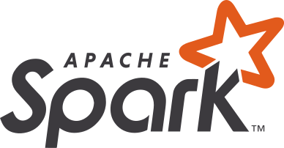
Azure Synapse Analytics
Limitless analytics service with unmatched time to insight
Artificial Intelligence / Machine Learning / Internet of Things
Intelligent Apps / Business Intelligence
Designed for analytics workloads at any scale
Synapse Analytics
SaaS developer experiences for code free and code first
Experience
Synapse Analytics Studio
Platform
Multiple languages suited to different analytics workloads
MANAGEMENT
Languages
MANAGEMENT
SQL
Python
.NET
Java
Scala
Integrated analytics runtimes available dedicated and serverless
Synapse SQL offering T-SQL for batch, streaming and interactive processing
Apache Spark for big data processing with Python, Scala and .NET
SECURITY
Form Factors
SECURITY
DEDICATED
SERVERLESS
MONITORING
Analytics Runtimes
MONITORING
SQL
METASTORE
METASTORE
DATA INTEGRATION
Integrated platform services for, management, security, monitoring, and meta-store
Azure
Data Lake Storage
Common Data Model
Enterprise Security
Optimized for Analytics
Data lake integrated and Common Data Model aware
Notes:
Hand it over to Lino

Slide 19









Modern Data Warehouse
INGEST
PREPARE
TRANSFORM & ENRICH
SERVE
VISUALIZE
AZURE SYNAPSE ANALYTICS
Synapse SQL (Dedicated)
Synapse Pipeline
Synapse SQL (Dedicated)
Data Sources
Synapse SQL (Serverless)
Synapse Pipeline
Power BI
OR
OR
Synapse Pipelines
Synapse SQL (Serverless)
Apache Spark
Apache Spark
Synapse SQL (Serverless)
STORE
ADLS Gen 2
Storage Account
Data Lake

Slide 20


Synapse Pipelines
Trigger
Pipeline
foreach (…)
On demand
Schedule
Data Window
Event
Activity
Activity
Activity
Activity
Activity
Self-hosted
Integration Runtime
Azure
Integration Runtime
Linked
Service
LEGEND
On-prem
Apps & Data
Azure Services
Command and Control
Data
Synapse Pipelines shares codebase with Azure Data Factory

Slide 21
Understanding Synapse Pipelines and ML Pipelines
 | Synapse Pipeline | ML Pipeline
Used for: | Data movement and transformation | Model training
Used by: | Data engineers | Data scientists

Slide 22
High level machine learning process
Business and data understanding
Data acquisition
Data preparation
Modeling
Model deployment and scoring
Notes:
The typical data science project has a certain number of repeatable processes.
It begins with business and data understanding. What problems are we looking to solve, and what types of data can help us solve that problem.
Data acquisition gathers the required data. Azure Synapse Analytics has powerful tools for data ingestion in the form of Synapse Pipelines.
When it comes to data preparation, leverage Synapse pipelines with features such as Data flows and notebooks. Data exploration and preparation in Synapse Analytics is quick with the use of tools like Apache Spark and serverless SQL pools; they can query data over raw files stored in the data lake. Further enhance data exploration with visualizations using several libraries available in Apache Spark and in the SQL query window by toggling to a fully customizable Chart view of the results.
Let’s take a moment now and dive deeper into the modeling and model deployment and scoring steps.

Slide 23
Modeling with Spark ML Algorithms
Classification and Regression | Linear Models (SVMs, logistic regression, linear regression) Naïve Bayes Decision Trees Ensembles of trees (Random Forest, Gradient-Boosted Trees) Isotonic regression
Clustering | k-means and streaming k-means Gaussian mixture Power iteration clustering (PIC) Latent Dirichlet allocation (LDA)
Collaborative Filtering | Alternating least squares (ALS)
Dimensionality Reduction | SVD PCA
Frequent Pattern Mining | FP-growth Association rules
Basic Statistics | Summary statistics Correlations Stratified sampling Hypothesis testing Random data generation
Spark ML Algorithms
Notes:
When it comes to Modeling, you have choices, you can begin with modeling directly in Apache Spark using tools like SparkMLlib or other popular libraries such as SciKit Learn. (SparkMLlib tutorial https://docs.microsoft.com/en-us/azure/synapse-analytics/spark/apache-spark-machine-learning-mllib-notebook).

Slide 24
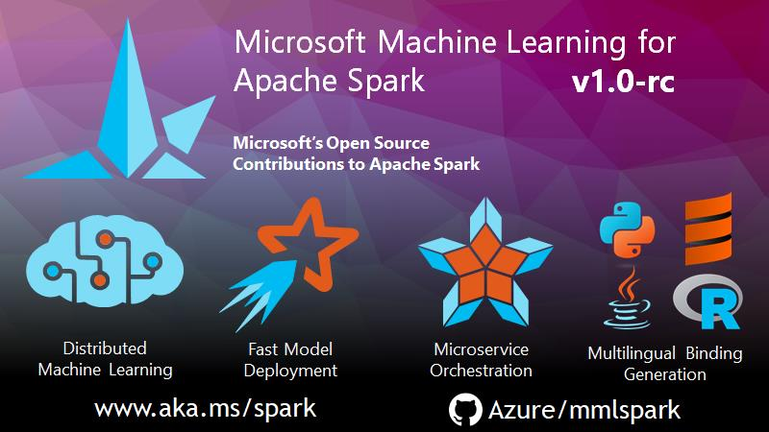
Notes:
MMLSpark is an ecosystem of tools aimed towards expanding the distributed computing framework Apache Spark in several new directions. MMLSpark adds many deep learning and data science tools to the Spark ecosystem, including seamless integration of Spark Machine Learning pipelines with Microsoft Cognitive Toolkit (CNTK), LightGBM and OpenCV. These tools enable powerful and highly-scalable predictive and analytical models for a variety of datasources.
MMLSpark also brings new networking capabilities to the Spark Ecosystem. With the HTTP on Spark project, users can embed any web service into their SparkML models. In this vein, MMLSpark provides easy to use SparkML transformers for a wide variety of Microsoft Cognitive Services. For production grade deployment, the Spark Serving project enables high throughput, sub-millisecond latency web services, backed by your Spark cluster.

Slide 25

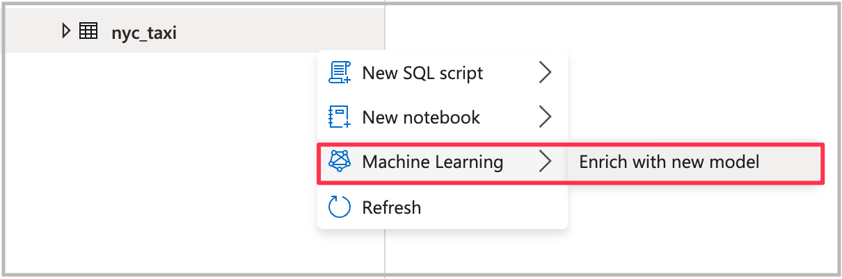
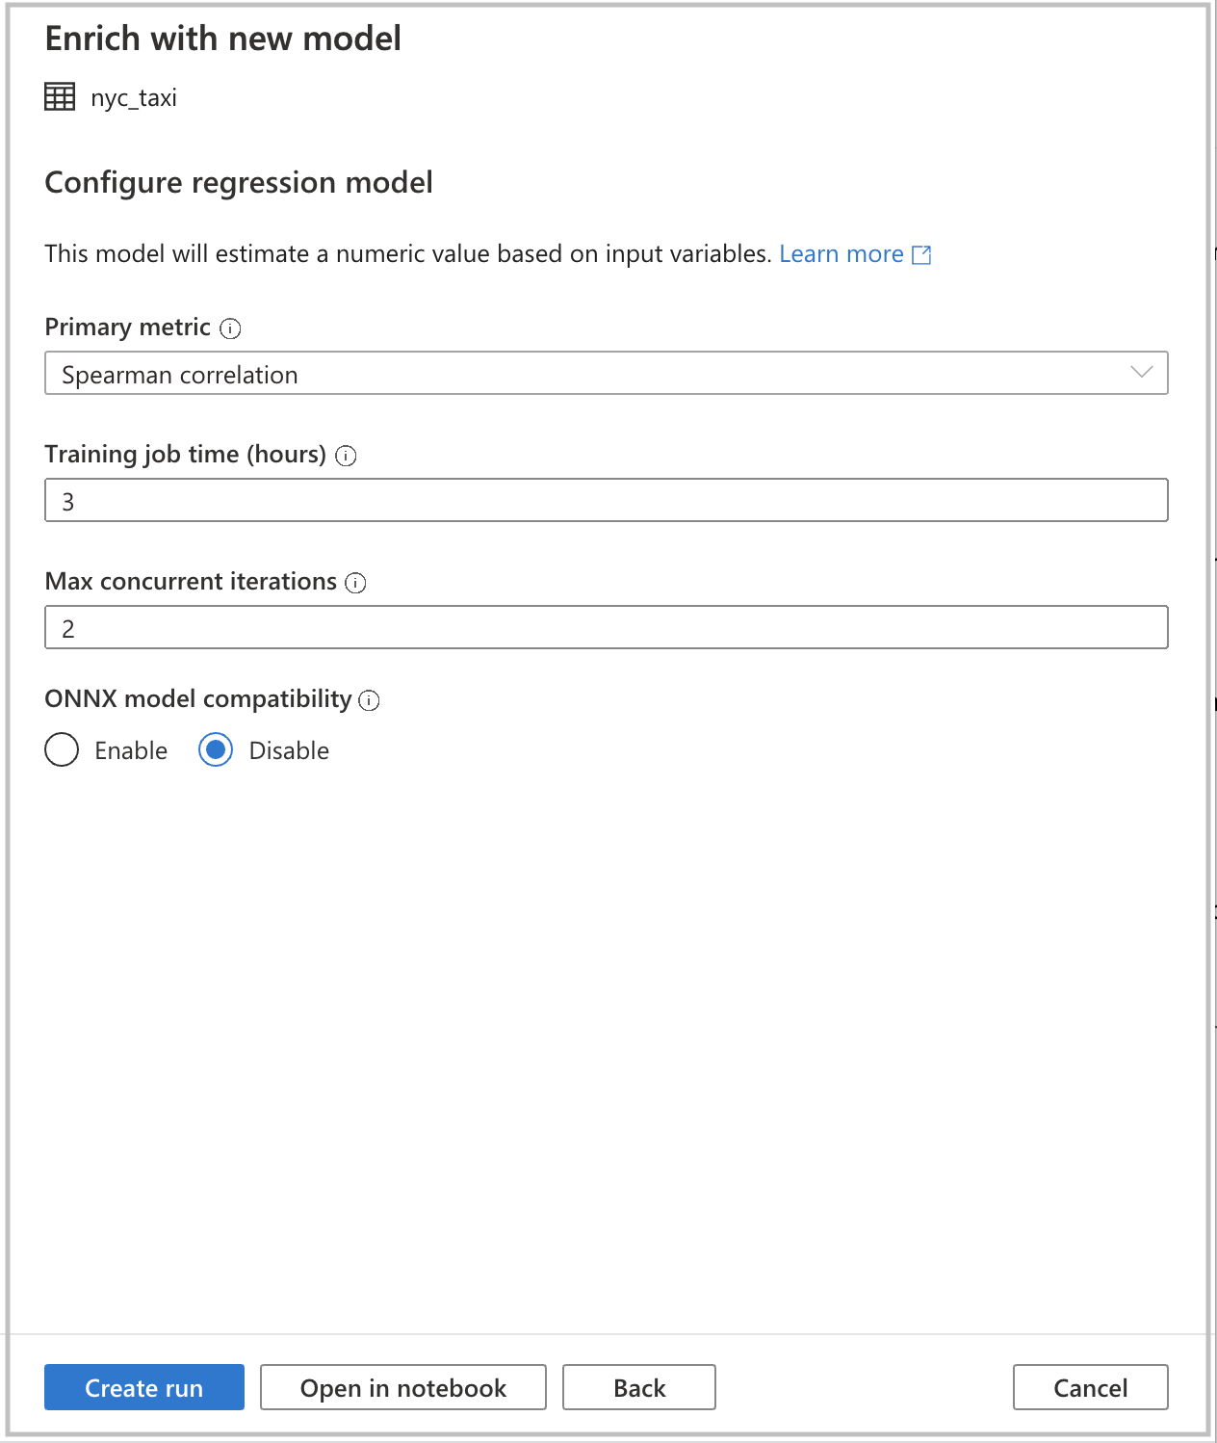



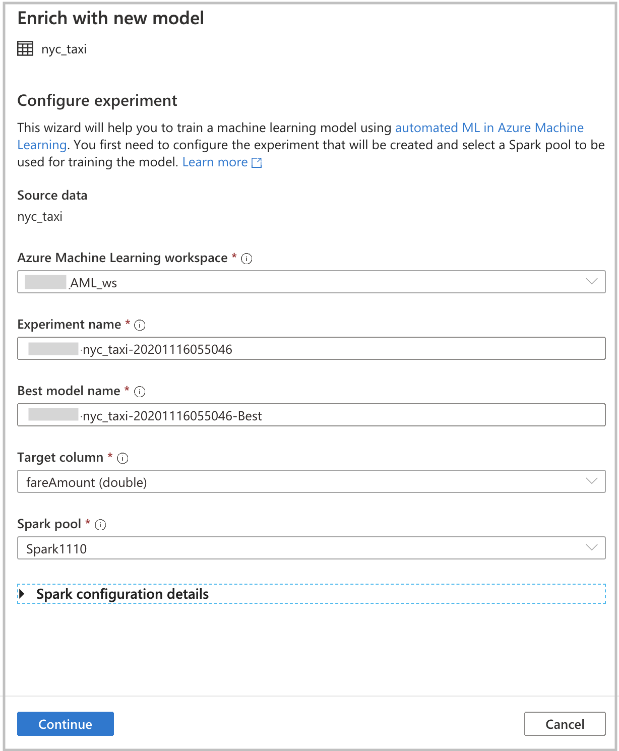
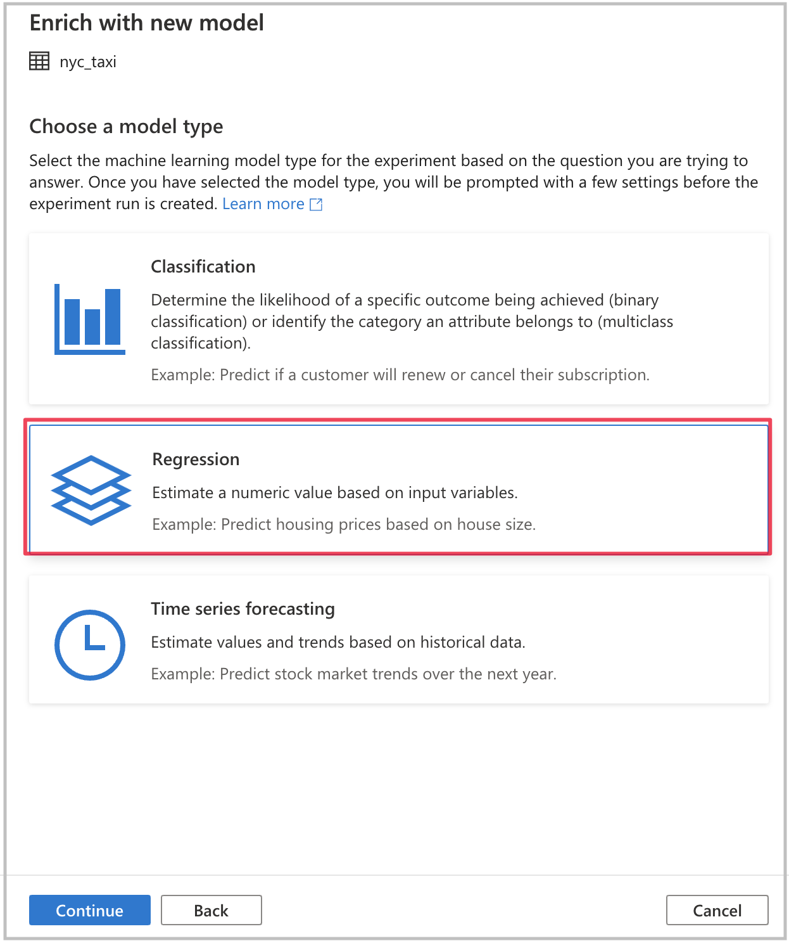
Modeling with Azure Machine Learning – Code Free
Notes:
Another way to train machine learning models, that does not require much prior familiarity with machine learning, is to use automated ML. Automated ML is a feature that automatically trains a set of machine learning models and allows the user to select the best model based on specific metrics.
Thanks to a seamless integration with Azure Machine Learning from Azure Synapse Notebooks, users can easily leverage automated ML in Synapse with passthrough Azure Active Directory authentication. This means that you only need to point to your Azure Machine Learning workspace and do not need to enter any credentials. (automated ML tutorial https://docs.microsoft.com/en-us/azure/synapse-analytics/spark/apache-spark-azure-machine-learning-tutorial)
Right-click on a Spark Table, select Enrich with new model.
After providing the settings and configuration of the experiment, you can select “Create run” in the UI to submit the experiment directly in Azure Machine Learning. If you would rather have it generate PySpark code instead, for a more code-centric approach, select the “Open in notebook” option.

Slide 26
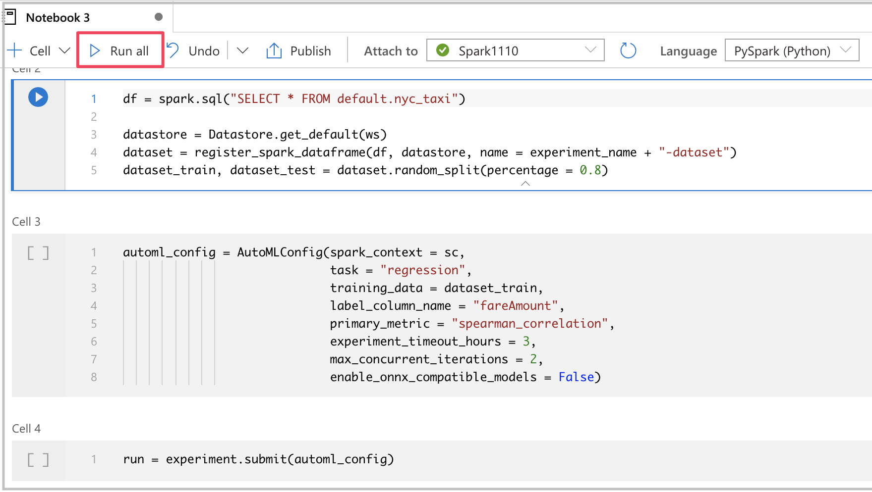
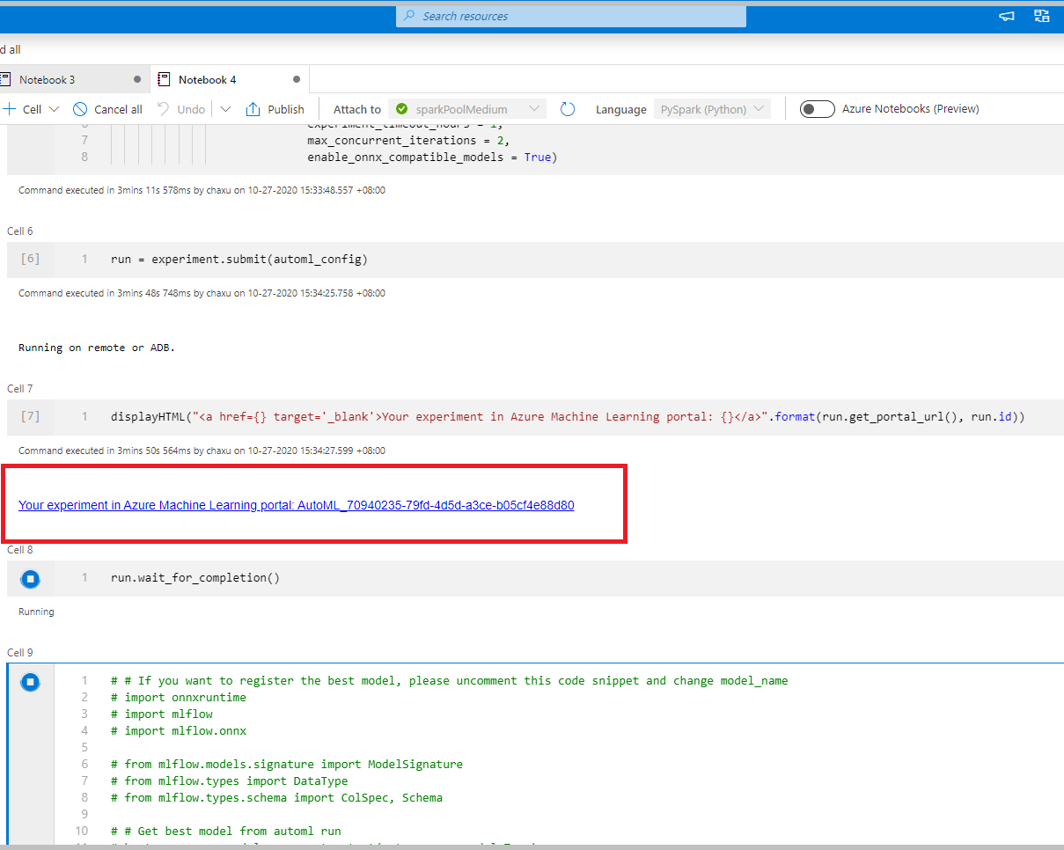
Modeling with Azure Machine Learning – With Code
Notes:
If you were to select “Open in notebook”, PySpark code is generated to create, configure, and submit the experiment to Azure Machine Learning.
Within the generated code, you also have the option of registering the trained model with MLFlow within the Azure Machine Learning workspace.

Slide 27
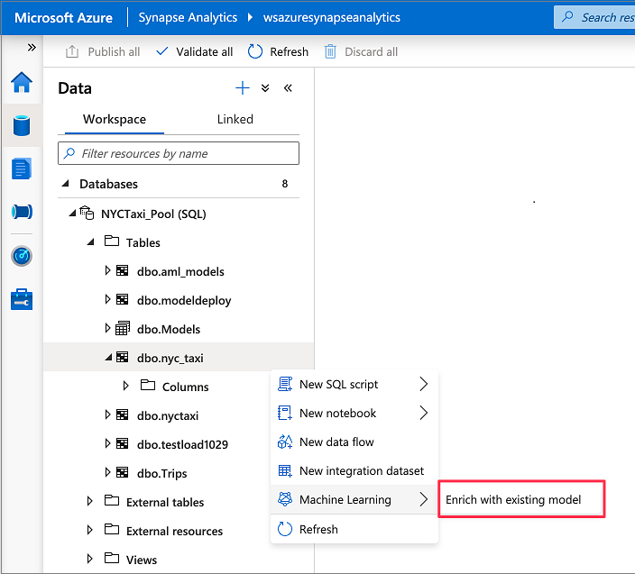
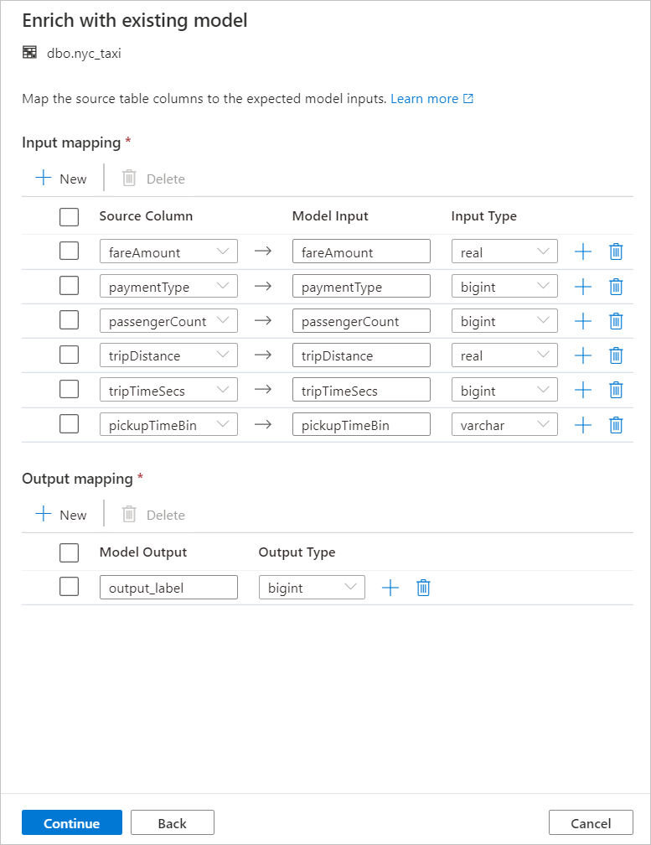
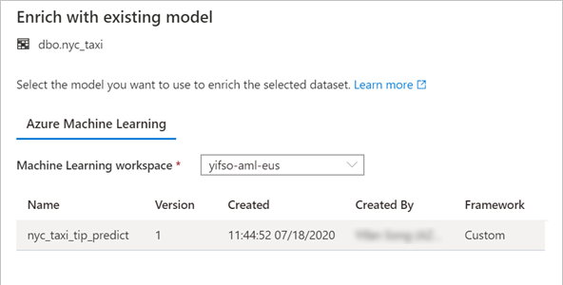
Model deployment and scoring – Code Free
Notes:
Models can be deployed several ways. One way is to create a service by deploying to ACI or Kubernetes. This can be automated through a Spark Notebook or by leveraging the deployment features of the Azure Machine Learning resource user interface. Within Synapse, you could train an ONNX model and store it directly in the SQL pool for use with the TSQL Predict function.
1) A SQL scoring wizard is available in Synapse Studio by right clicking a table, and selecting “Enrich with Existing Model”.
2) This action will let you select models registered in a linked azure machine learning workspace.
3) Based on the columns of the data table, you are able to map the input columns to the input of the model.

Slide 28
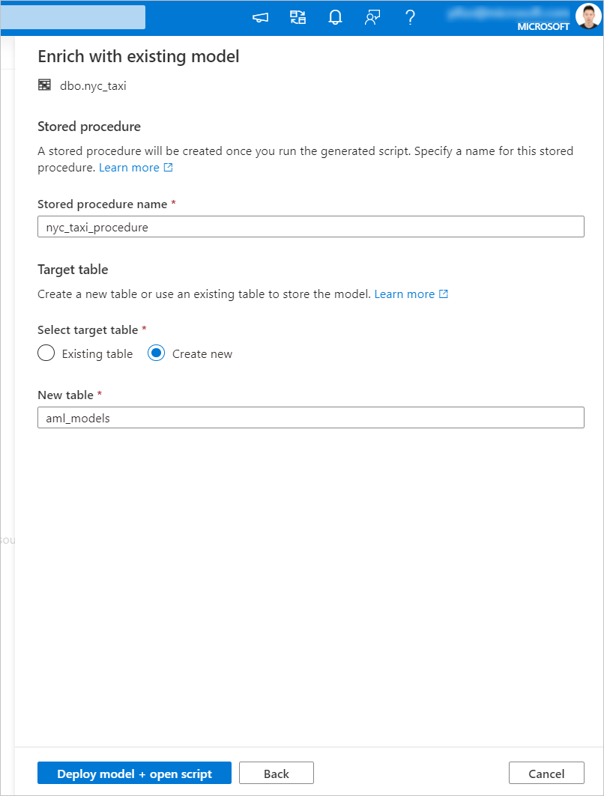
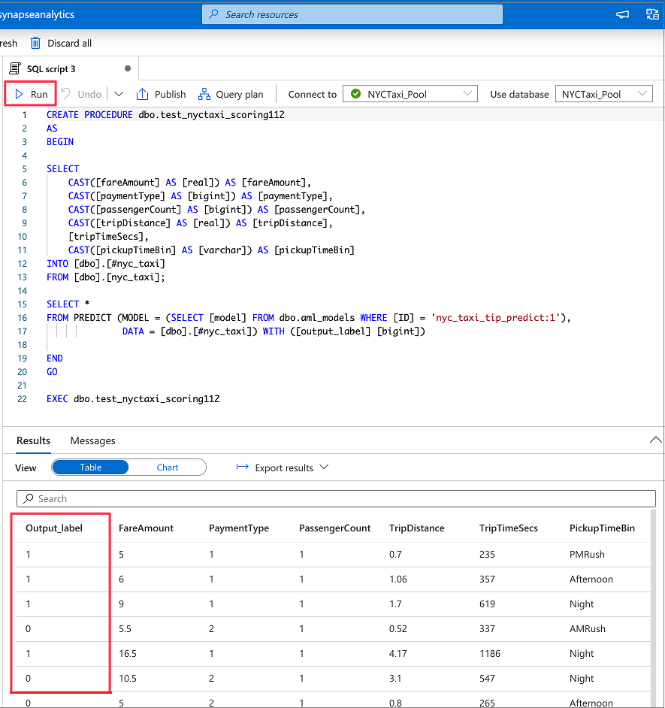

Model deployment and scoring – Code Free (cont…)
Notes:
4) The scoring wizard generates a stored procedure to exercise the model, and will also store the model physically in the database in the table of your choice, whether it be an existing table or a completely new one.
5) The stored procedure script is then displayed and you could run the model based on the dataset specified in the previous steps.
Another option, of course, is to leverage the code experience in Apache Spark Pools for Azure Synapse for your batch scoring and use SDKs to deploy to ACI, Kubernetes, or the destination of your choice.

Slide 29
Predict
Overview
It provides ability to import existing machine learning models and score them within provisioned SQL. It takes ONNX (Open Neural Network Exchange) and data as inputs and generates prediction based on model.
Benefits
It empowers data engineers to successfully deploy machine learning models with the familiar T-SQL interface
It offers seamless collaboration with data scientists
It generates new columns, but the number of columns and their data types depends on the type of model that was used for prediction.
Syntax:
PREDICT
(
MODEL = @model | model_literal,
DATA = object AS <table_alias>
)
WITH ( <result_set_definition> )
<result_set_definition> ::=
{
{ column_name
data_type
}
[,...n ]
}
MODEL = @model | model_literal
Example:
DECLARE @model varbinary(max) = (SELECT Model FROM Models WHERE Id = <>);
SELECT d.*, p.Score
FROM PREDICT(MODEL = @model,
DATA = dbo.mytable AS d) WITH (Score float) AS p;

Slide 30
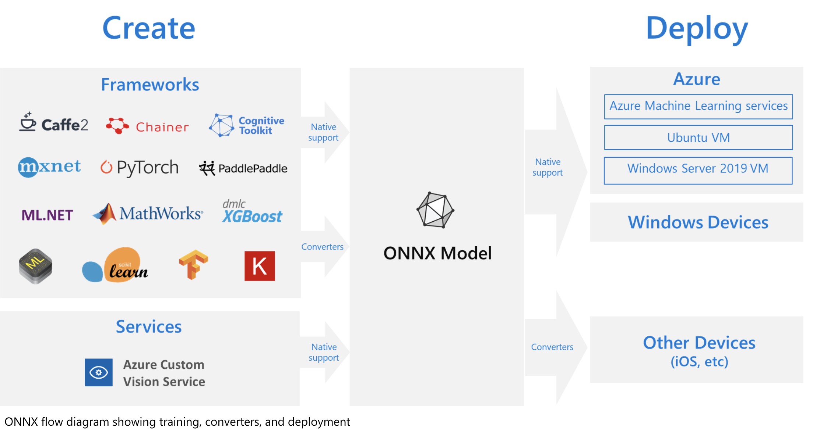
What is ONNX?
Notes:
The challenges of optimizing the performance of machine learning models in production is extremely hard considering the range of hardware capabilities on different platforms such as cloud vs edge, CPU vs GPU etc. and couple that with the variety of frameworks that available for building and training the machine learning models.
To support the idea of providing users the flexibility to train their machine learning models on framework of their choice, and run that model anywhere with optimal performance, is at the core of Open Neural Network Exchange (ONNX) format for representing machine learning models. ONNX is an open format, that is supported by a community of partners, including Microsoft, who create compatible frameworks and tools.
You can create ONNX models from many frameworks, including PyTorch, Chainer, Microsoft Cognitive Toolkit (CNTK), MXNet, ML.Net, TensorFlow, Keras, SciKit-Learn, and more. ONNX Runtime is optimized for both cloud and edge and works on Linux, Windows, and Mac, and it also integrates with accelerators on different hardware such as TensorRT on NVidia GPUs. ONNX models can be deployed to the cloud using Azure Machine Learning and ONNX Runtime. They can also be deployed to Windows 10 devices using Windows ML. They can even be deployed to other platforms using converters that are available from the ONNX community.
The interoperability you get with ONNX makes it possible to get great ideas into production faster. With ONNX, data scientists can choose their preferred framework for the job. Similarly, developers can spend less time getting models ready for production, and deploy across the cloud and edge.
Data scientists: use the framework of their choice to create and train models
Developers: deploy models cross-platform with minimal integration work

Slide 31
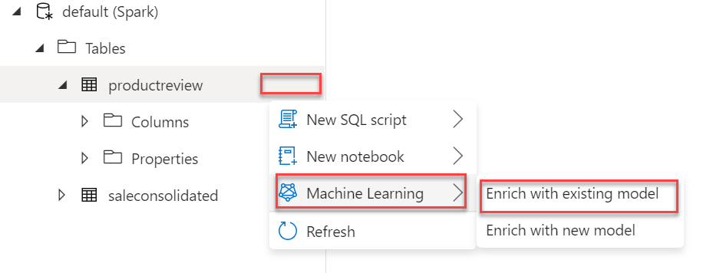
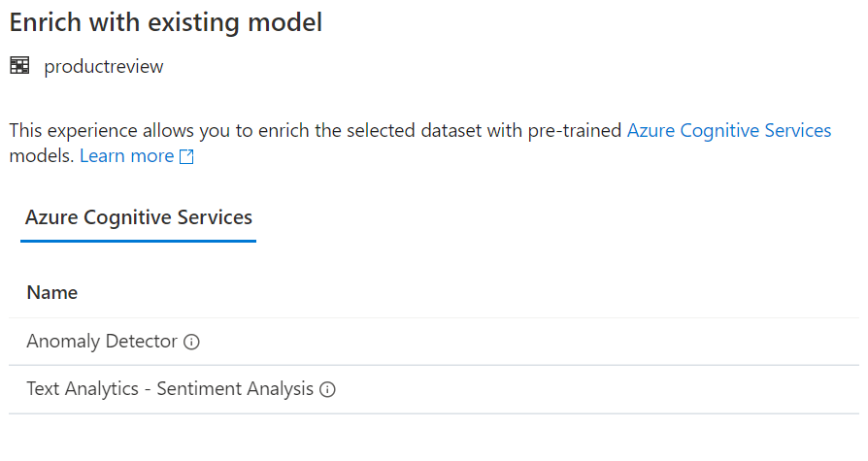
Leveraging Cognitive services
Enrich with existing model
Select from the Cognitive Services available
Choose the appropriate Cognitive Service resource
Cog. Svc. API Key must be stored in a Key Vault
Set input column
Generates a PySpark Notebook that applies the cognitive service model to the column chosen
Notes:
Enrich with existing model allows you to select the type of Cognitive Services you wish to consume.
You will be given the choice of Cognitive Services accounts that are available in your subscription
The Cognitive Services Key must be stored in an Azure Key Vault secret
The wizard will output a Spark Notebook that executes the chosen Cognitive Service against the columnar data chosen from the Spark table.

Slide 32
BRK13 – Azure Machine Learning integration with Azure Databricks
<Presenter name>
<Presenter title>

Slide 33
Agenda
Introduce Spark
Introduce Databricks
How AML plays in the ecosystem

